Slide 1
Lesson 8 – Homework review

Slide 2
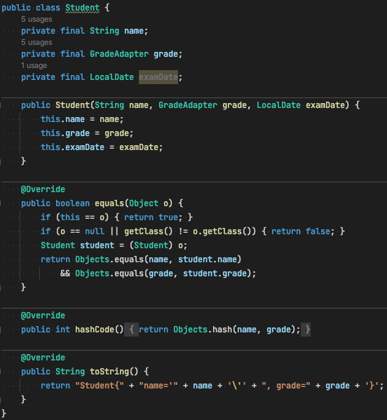
Equality problem

Slide 3
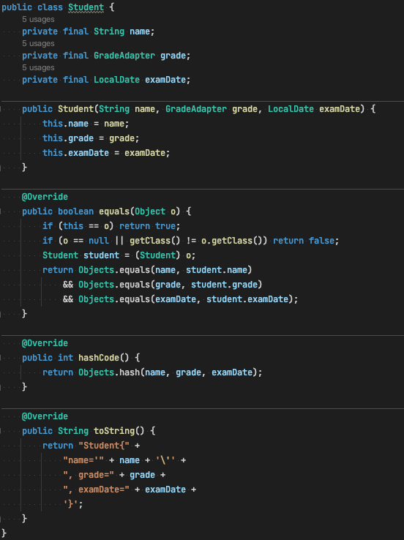
Equality problem

Slide 4
Equality problem

Slide 5
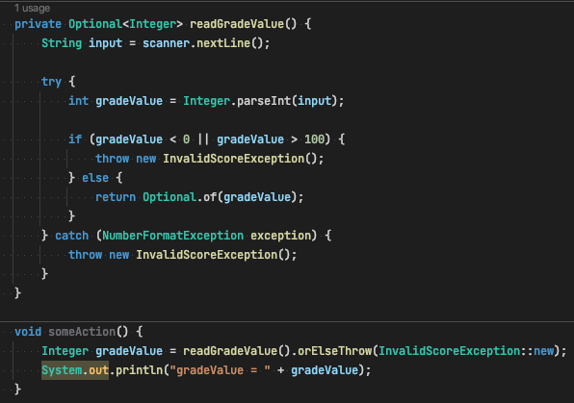
Optional vs Exception (also DRY)

Slide 6
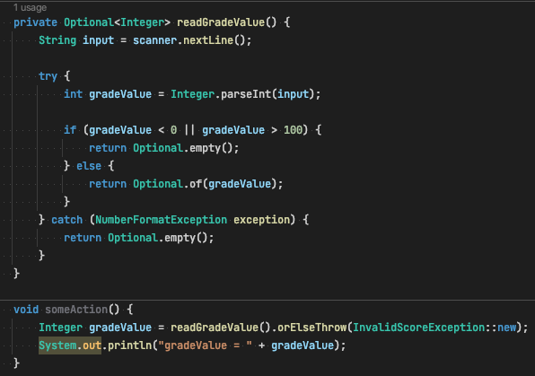
Optional vs Exception (also DRY)

Slide 7
Thanks!
Any Questions?
Or find us in Slack:
@Yaroslav Brahinets
@Vasya Rudas

